Slide 1

Engineering Case Studies (3)
Professor Bo Liu
James Watt School of Engineering

Slide 2
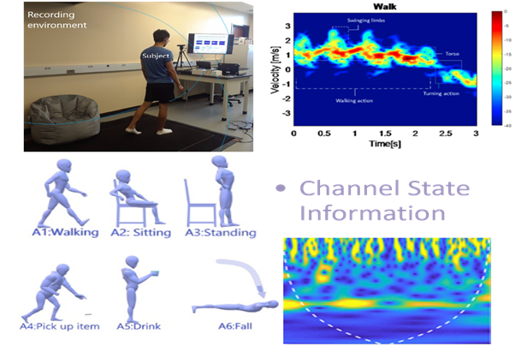
Radar signal processing: Human activity recognition
Human activity recognition research in radar typically include the following steps:
Data Collection
Pre-processing
Feature Extraction, Selection and Fusion
Classification

Slide 3
Radar signal processing: feature selection
Problem description
Different features (x) can be used to establish a state recognition system.
The i-th feature have two values: 0 and 1.
  When x_{i}=0, the feature is not selected as a modeling feature.
  When x_{i}=1, the feature is selected as a modeling feature.
  The aim of feature selection is to maximize the prediction accuracy of activity recognition system.

Slide 4
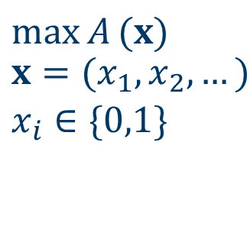
Radar signal processing: optimization
How to formulate the problem into an optimization problem?
Combinatorial optimization
$$\max{A}(x) \\ \begin{matrix}\begin{aligned}&x=(x_{1},x_{2},…) \\ &x_{i}∈\{0,1\}\end{aligned} \\ \end{matrix}$$
Objective function
Decision variables

Slide 5




Thanks!
#UofGWorldChangers
@UofGlasgow

